Slide 1
클러스터링
모두를 위한 머신러닝
세종대학교 고승호

Slide 2
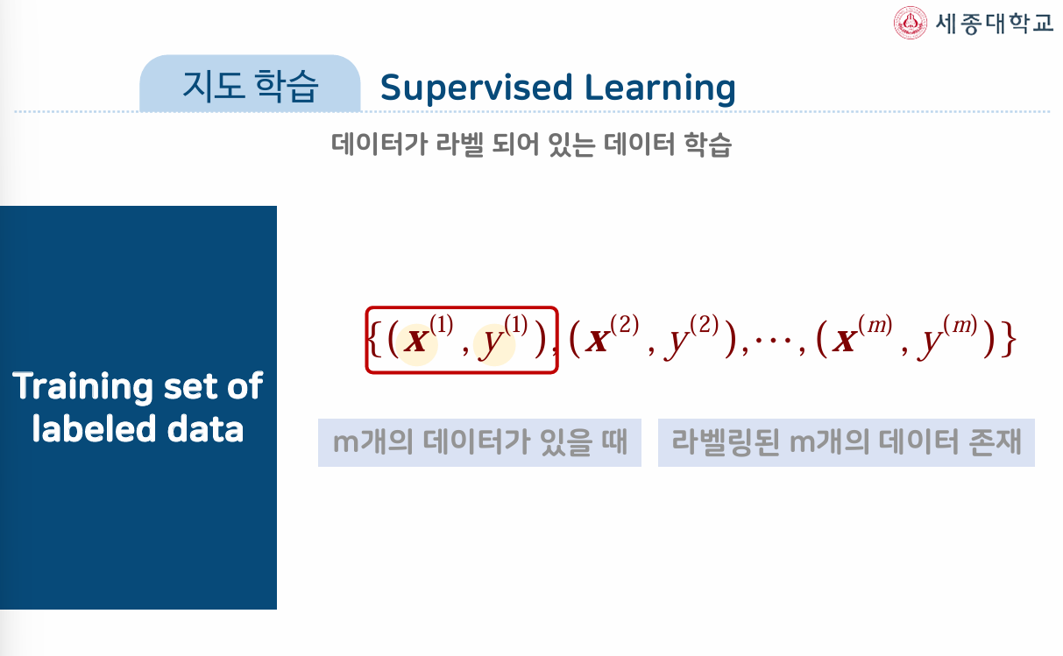
지도학습과 비지도학습

Slide 3
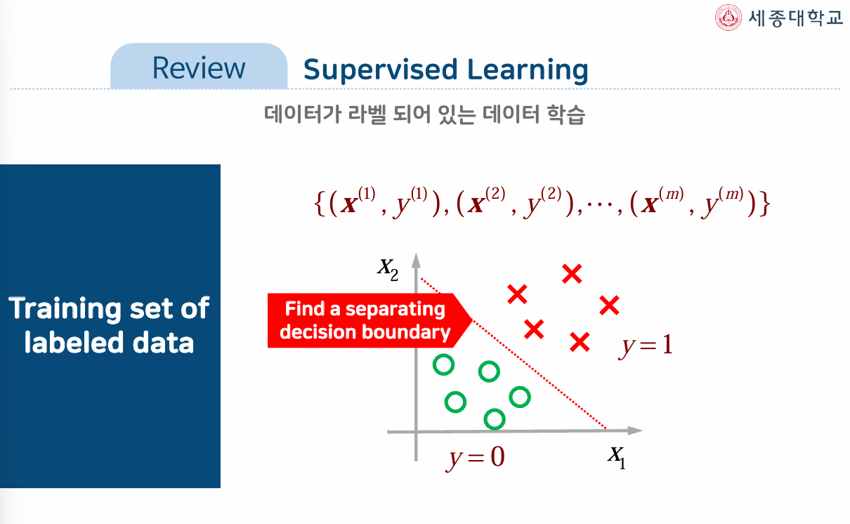
지도학습과 비지도학습

Slide 4
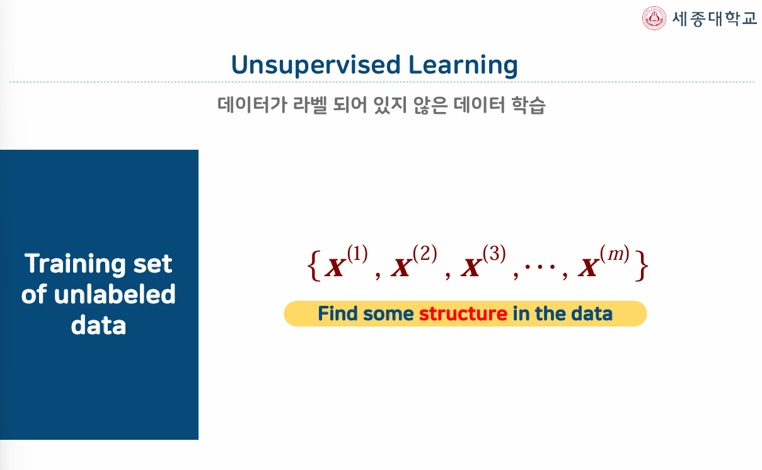
지도학습과 비지도학습

Slide 5
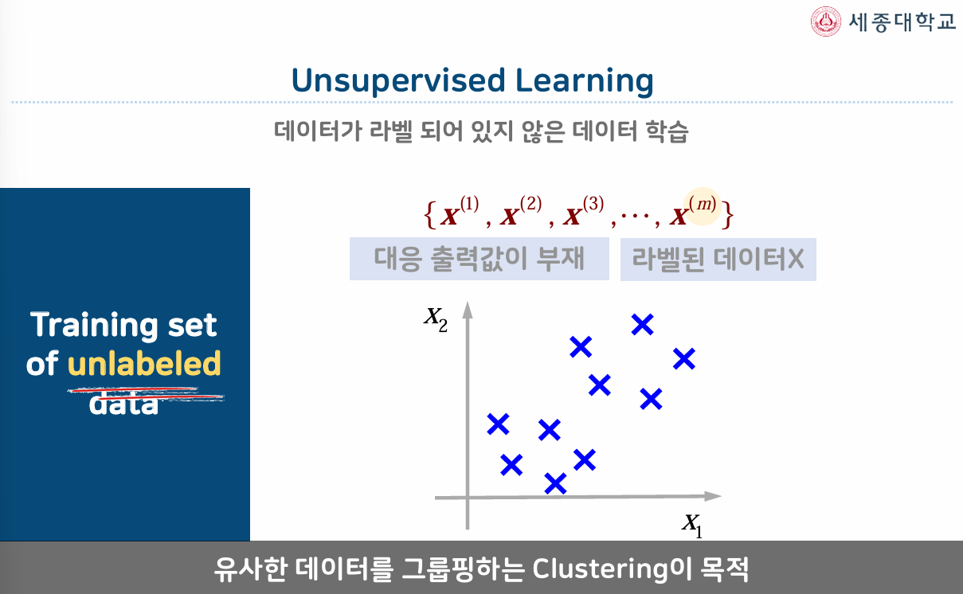
지도학습과 비지도학습

Slide 6
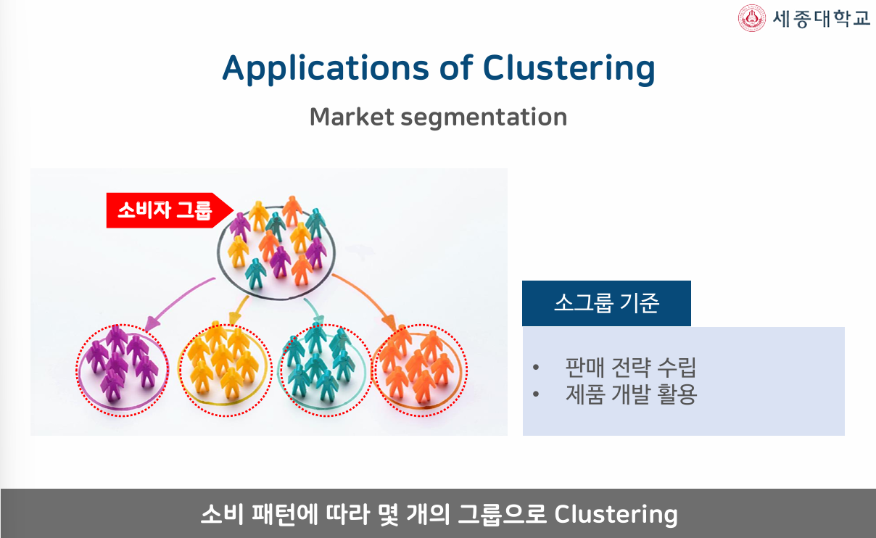
클러스터링 적용

Slide 7
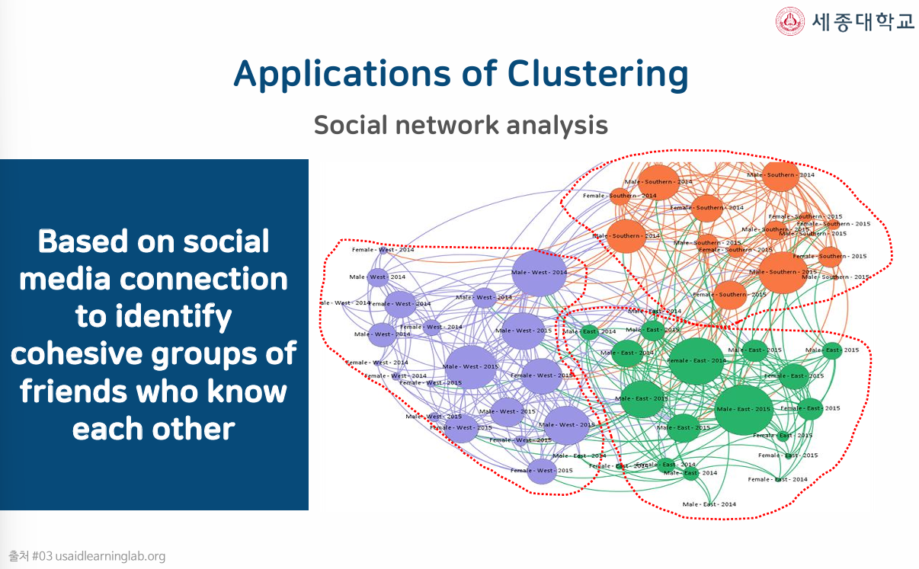
클러스터링 적용

Slide 8
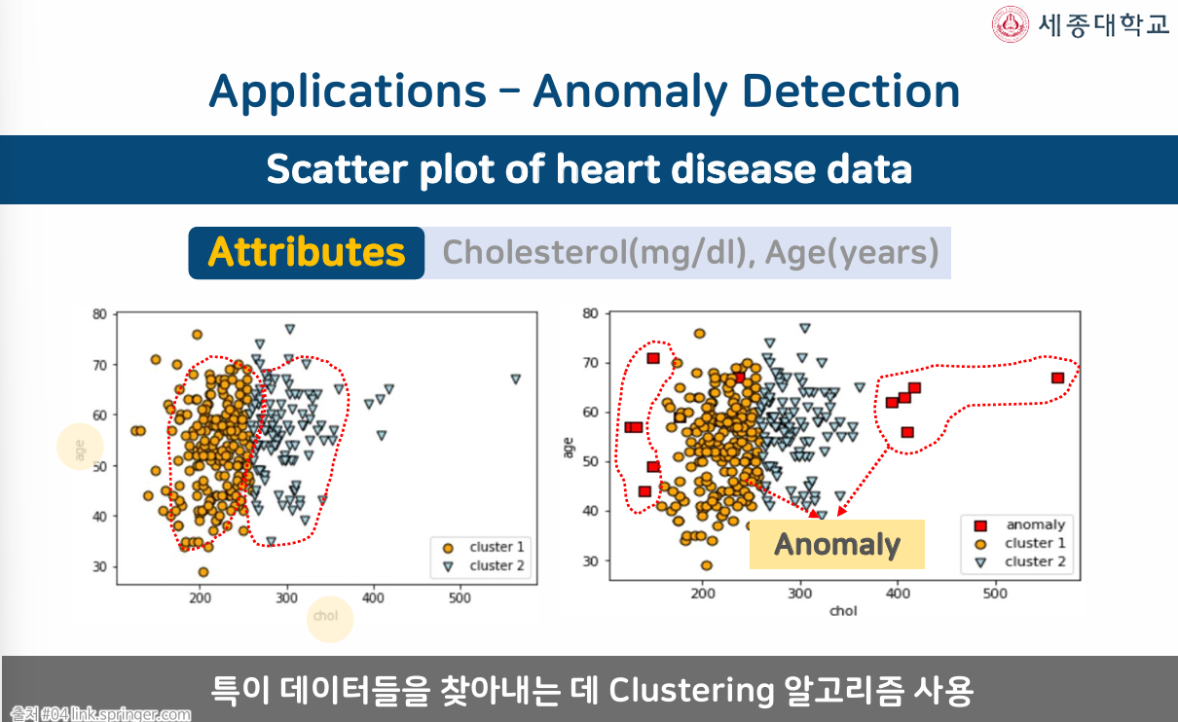
클러스터링 적용

Slide 9
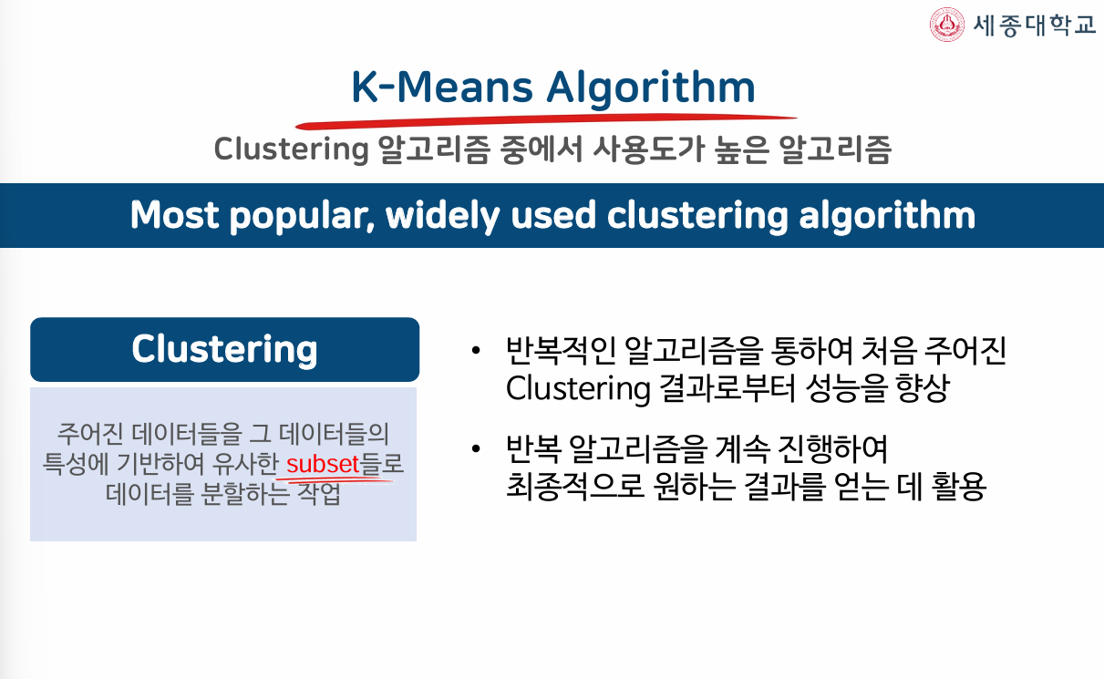
K-Means Algorithm

Slide 10
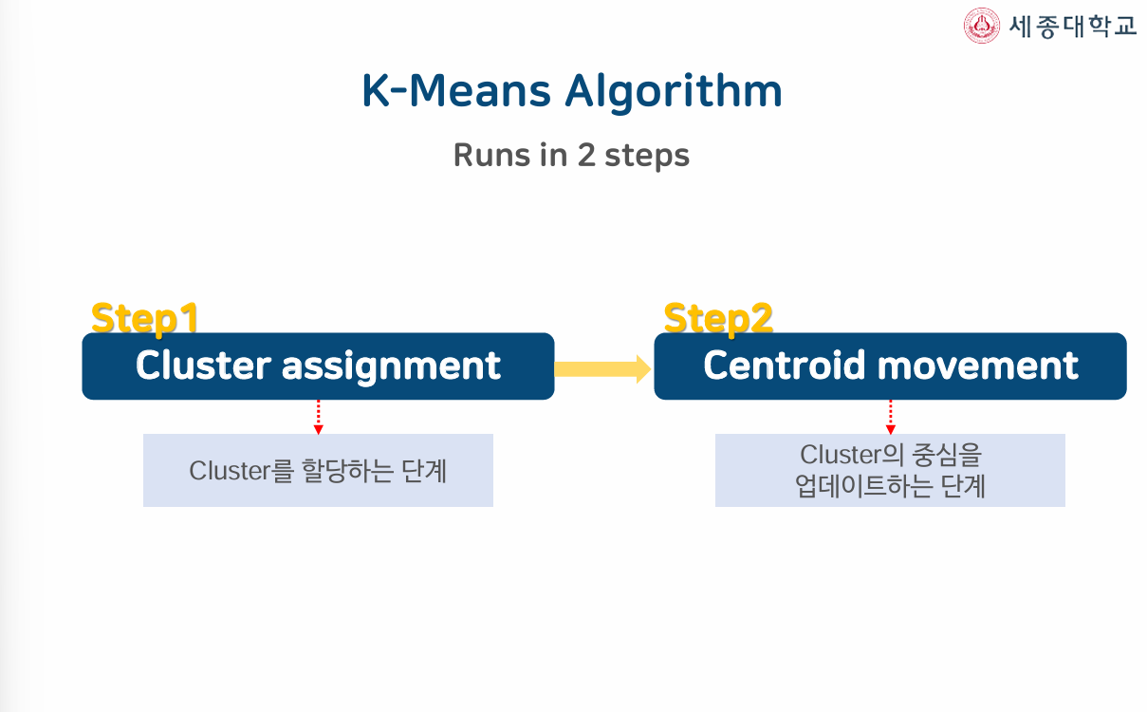
K-Means Algorithm

Slide 11
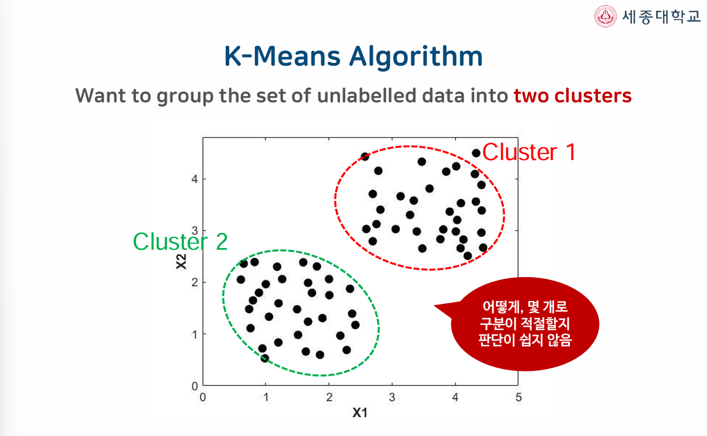
K-Means Algorithm

Slide 12
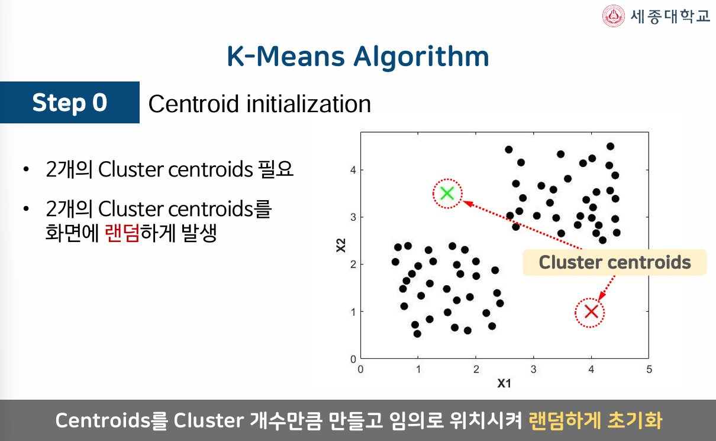
K-Means Algorithm

Slide 13
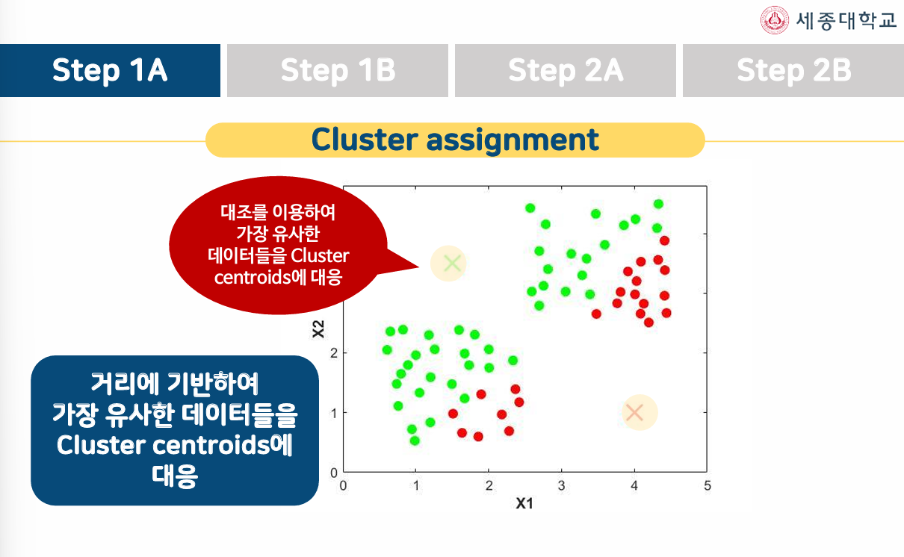
K-Means Algorithm

Slide 14
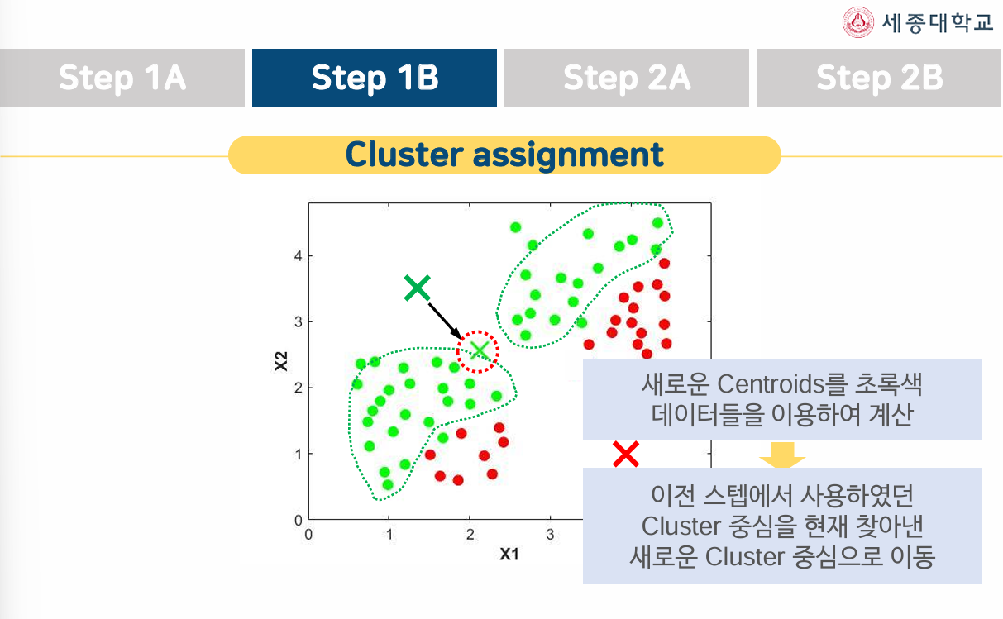
K-Means Algorithm

Slide 15
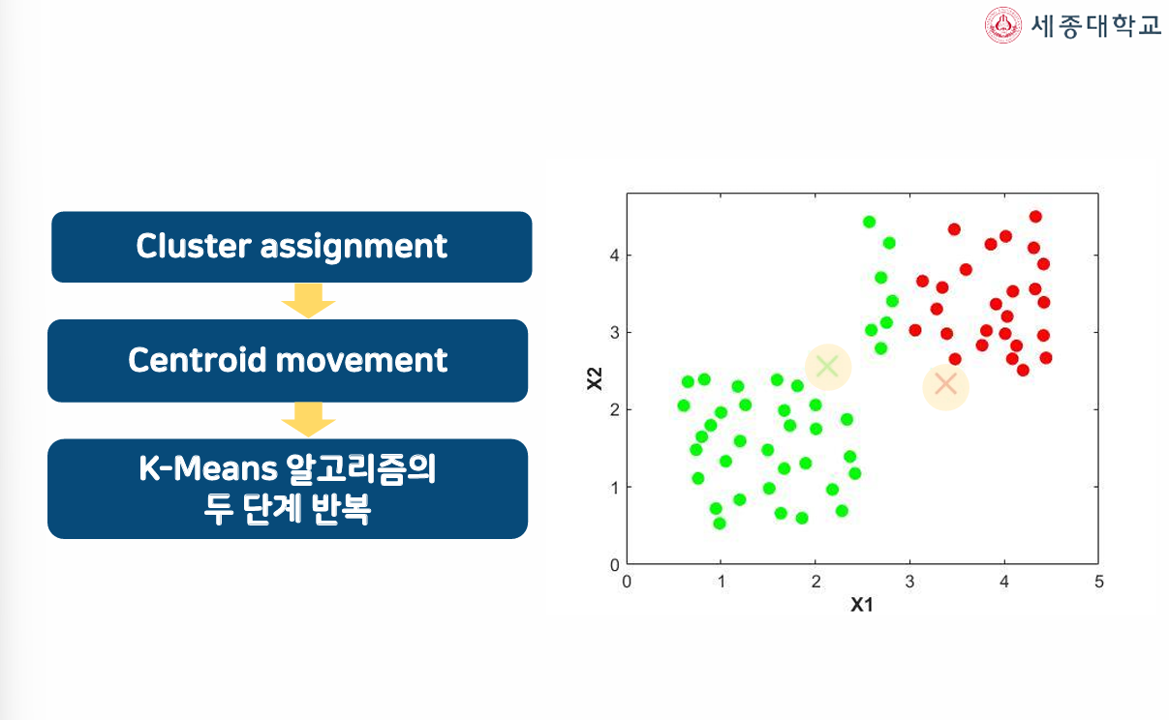
K-Means Algorithm

Slide 16
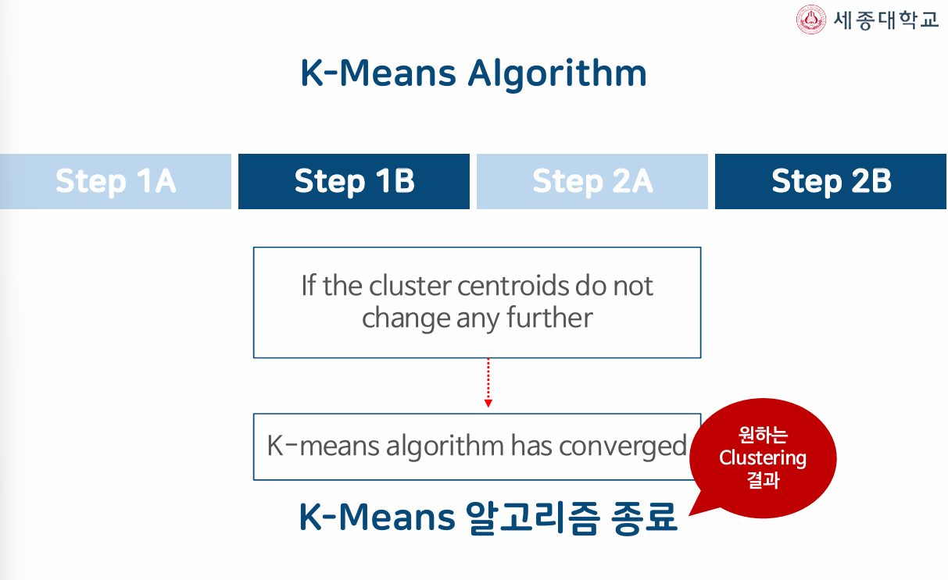
K-Means Algorithm

Slide 17
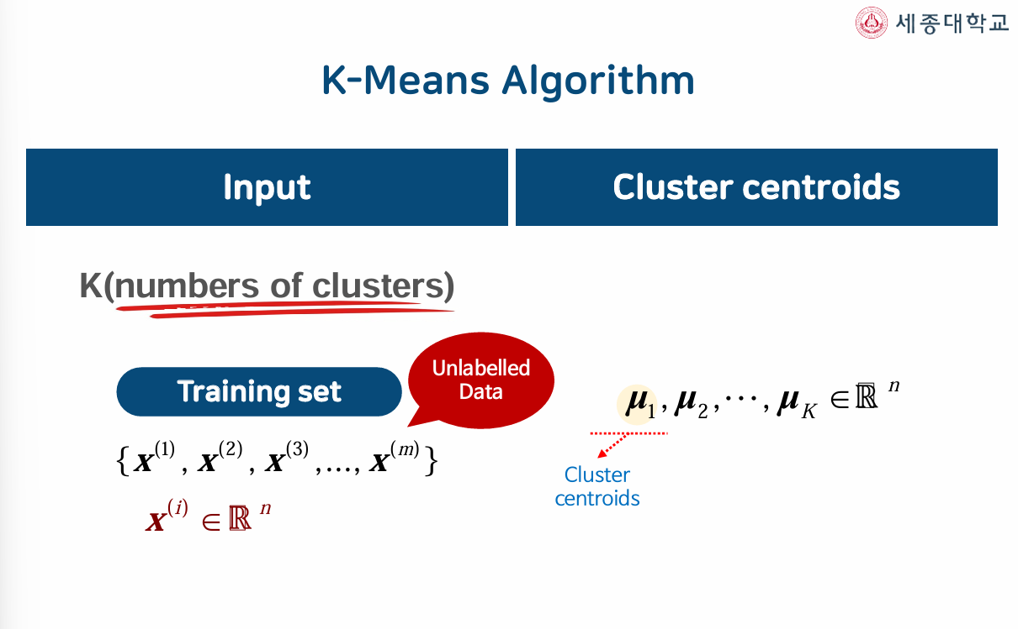
K-Means Algorithm

Slide 18
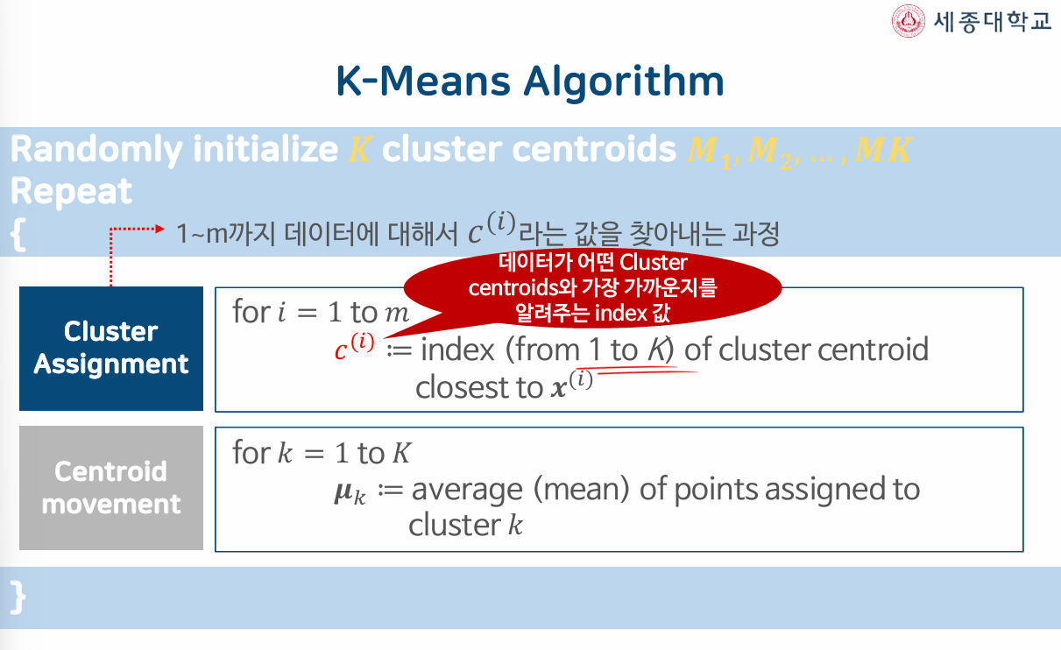
K-Means Algorithm

Slide 19
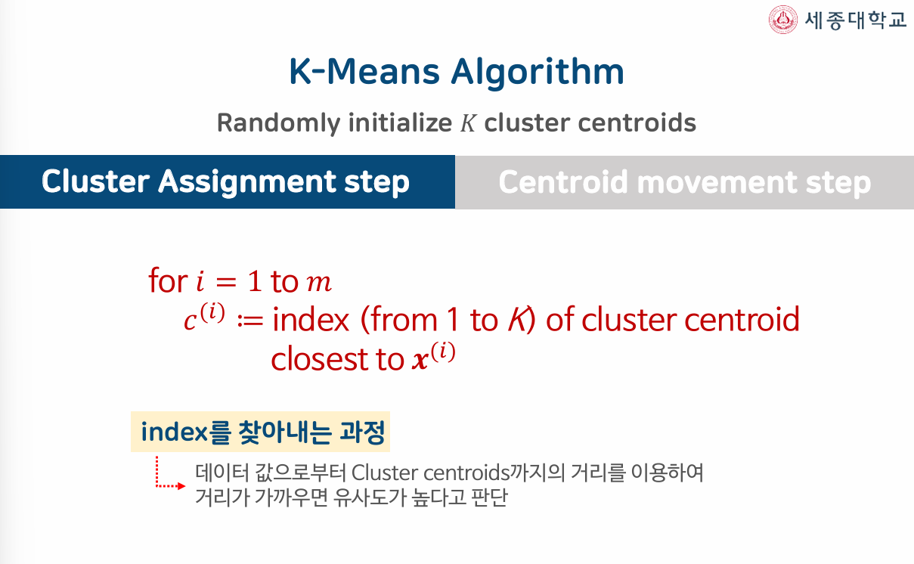
K-Means Algorithm

Slide 20
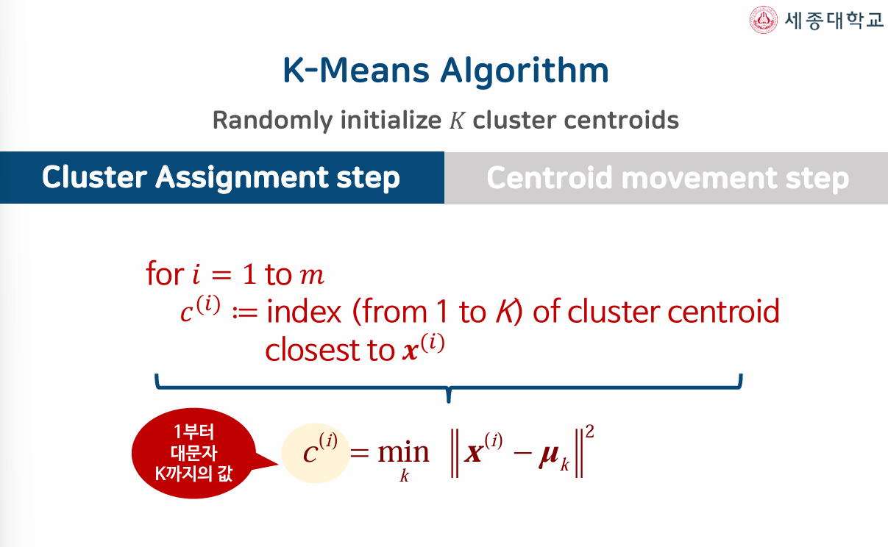
K-Means Algorithm

Slide 21
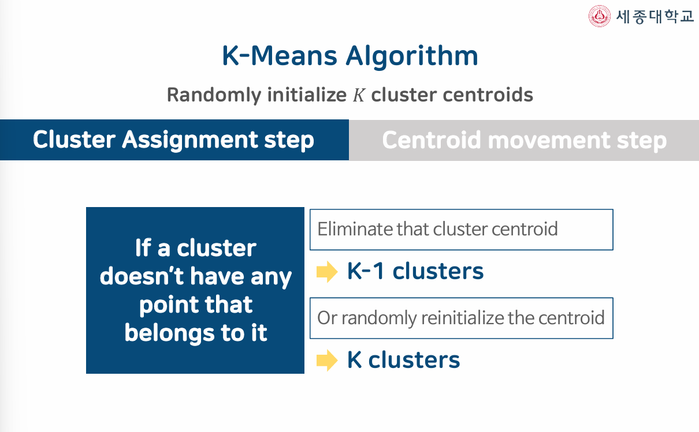
K-Means Algorithm

Slide 22
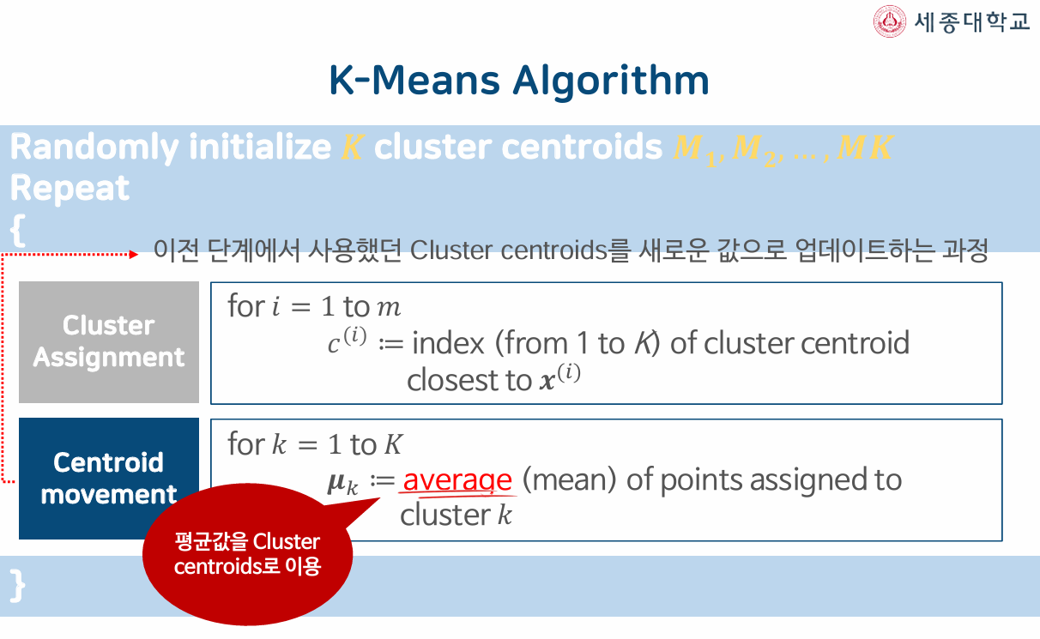
K-Means Algorithm

Slide 23
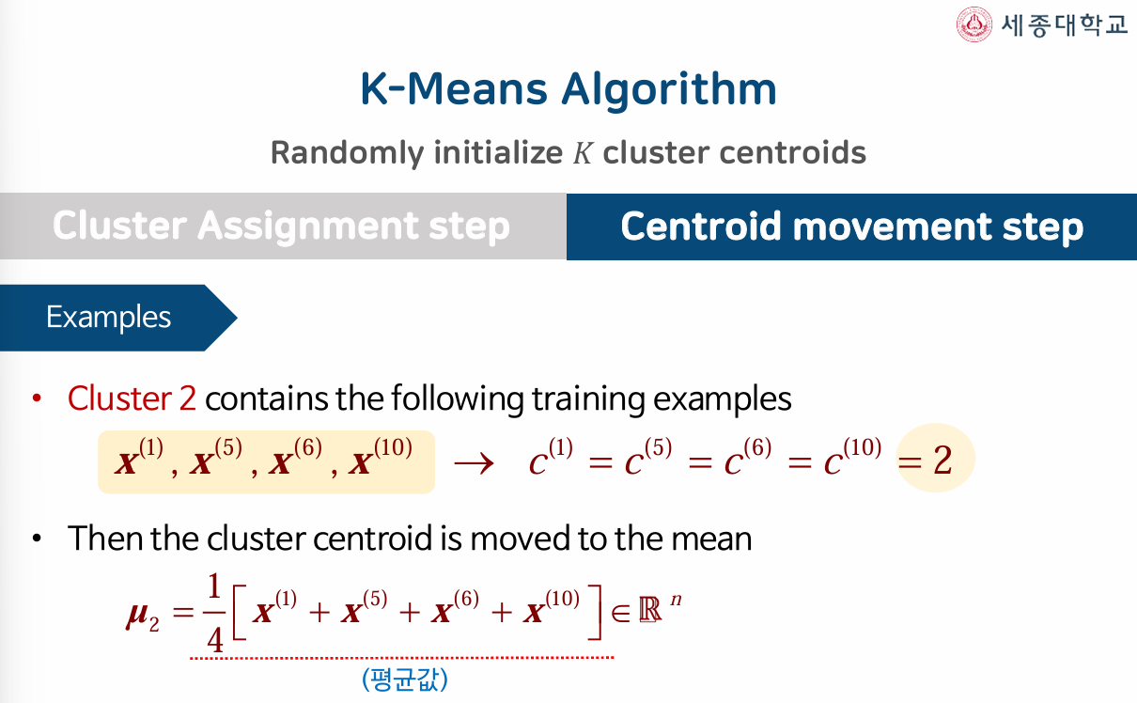
K-Means Algorithm

Slide 24
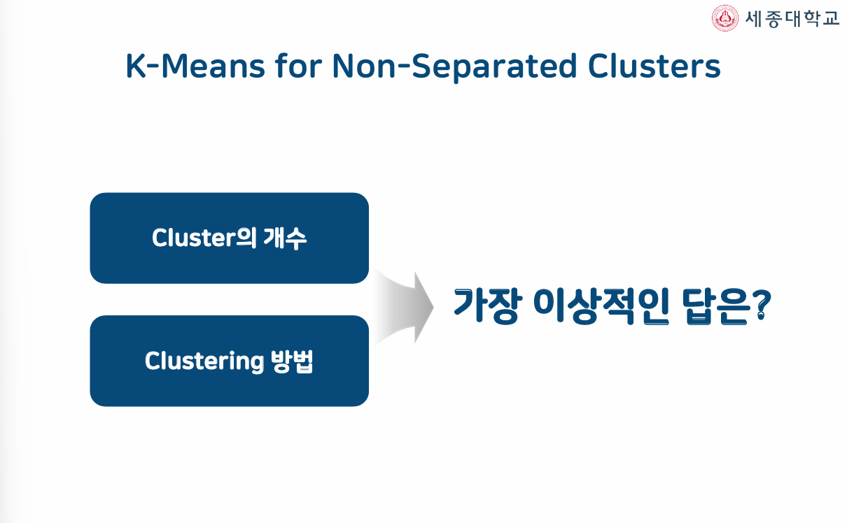
K-Means Algorithm

Slide 25
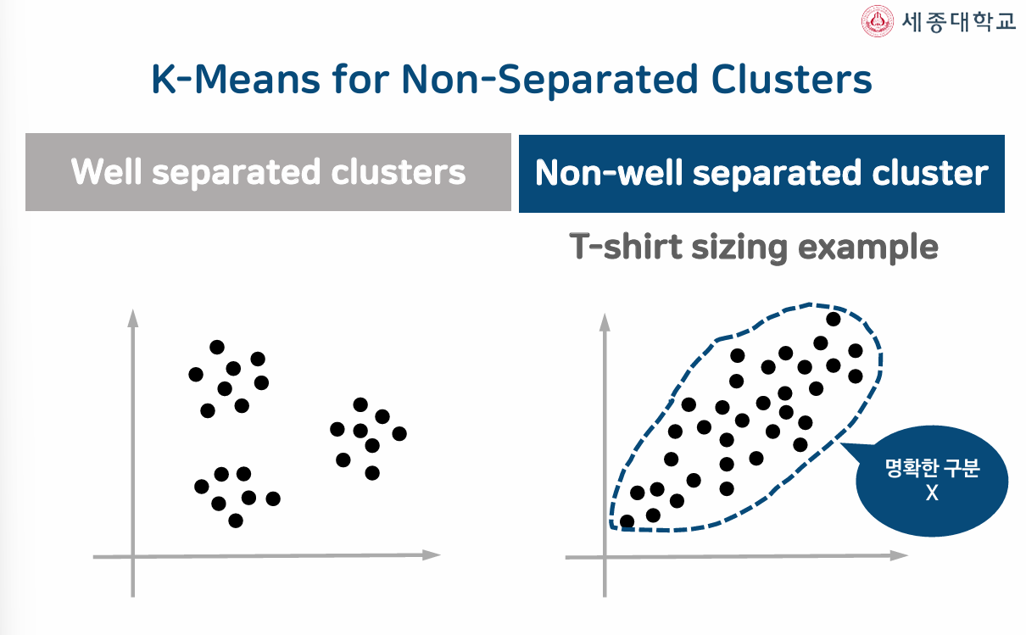
K-Means Algorithm

Slide 26
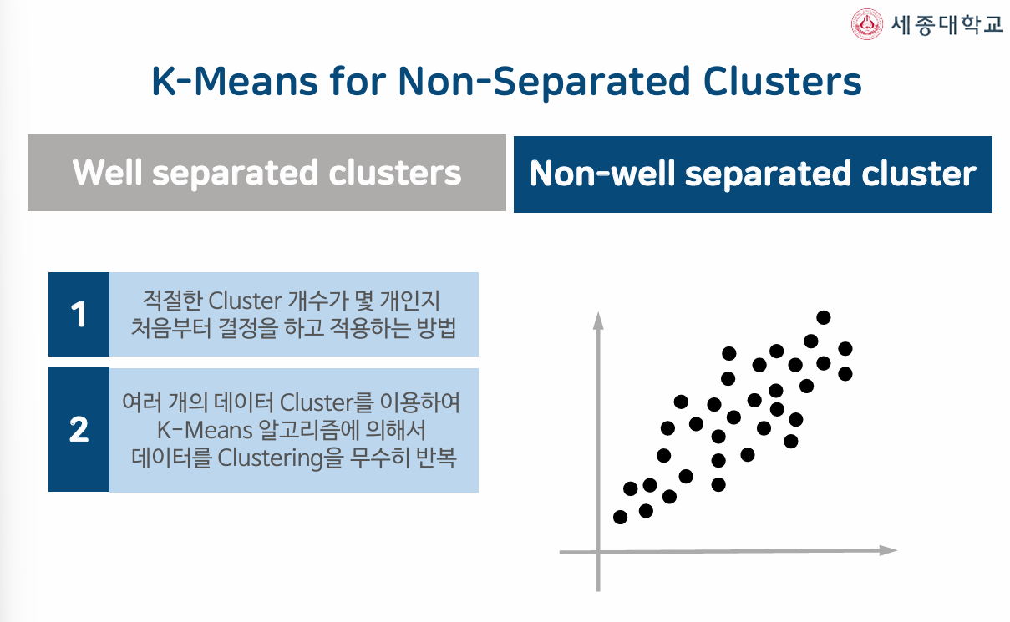
K-Means Algorithm

Slide 27
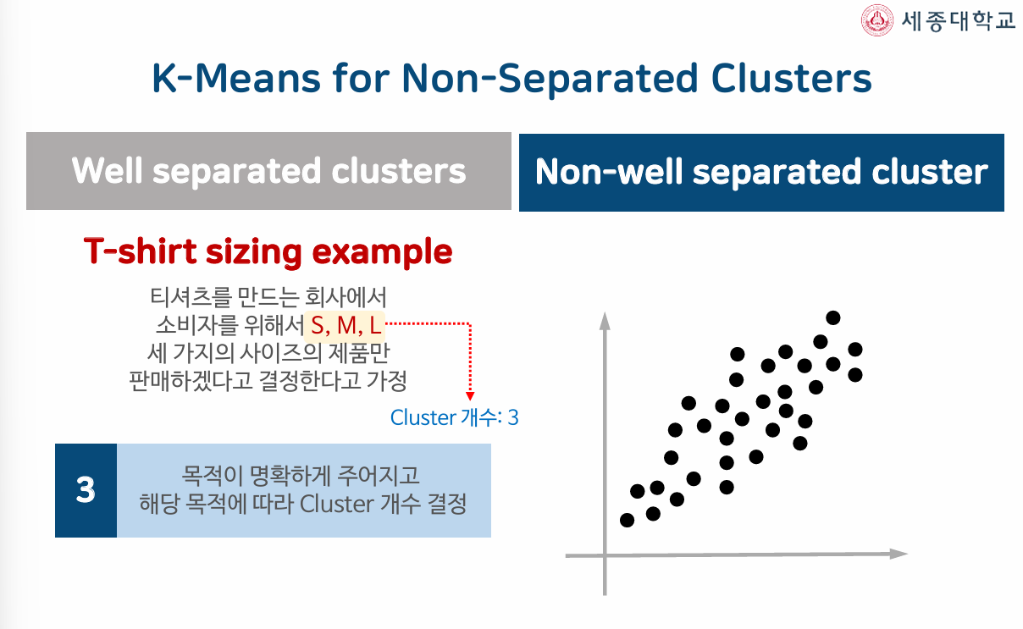
K-Means Algorithm

Slide 28
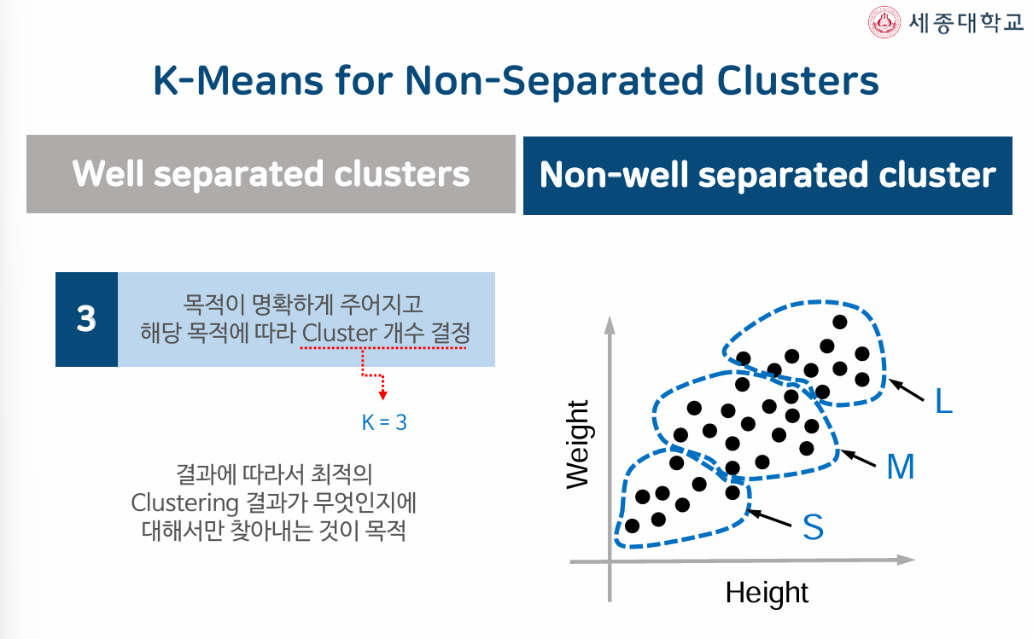
K-Means Algorithm

Slide 29
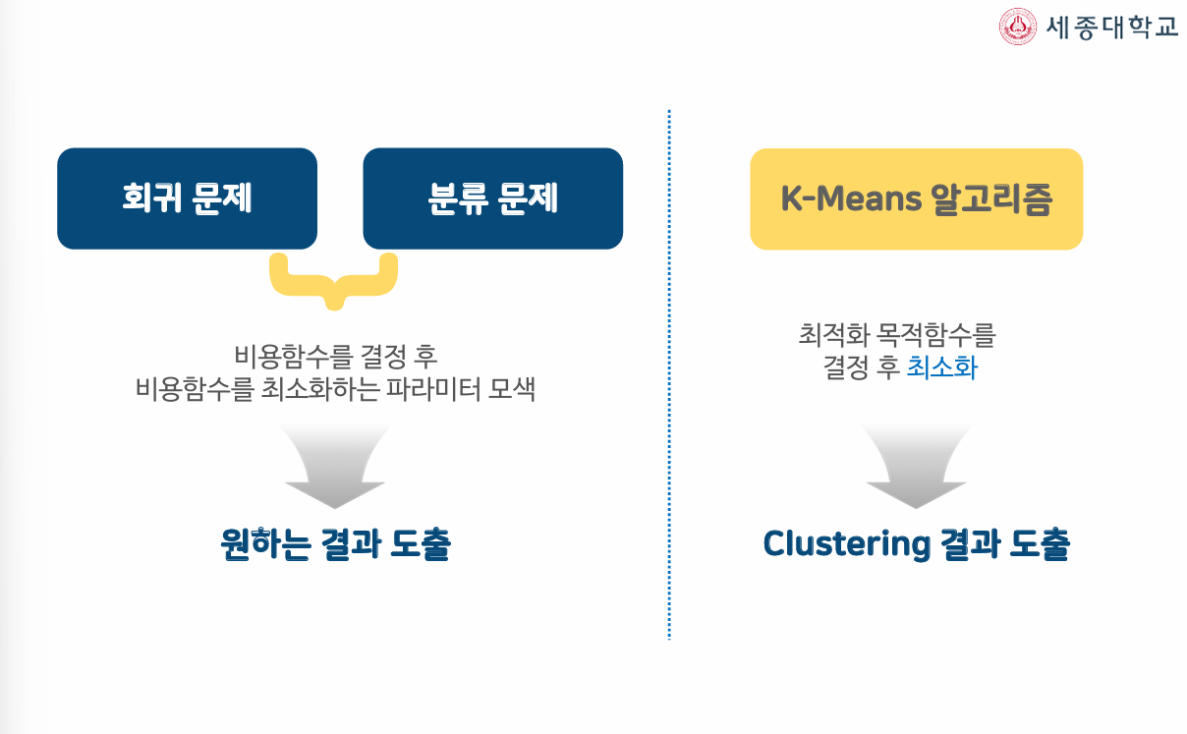
K-Means Algorithm

Slide 30
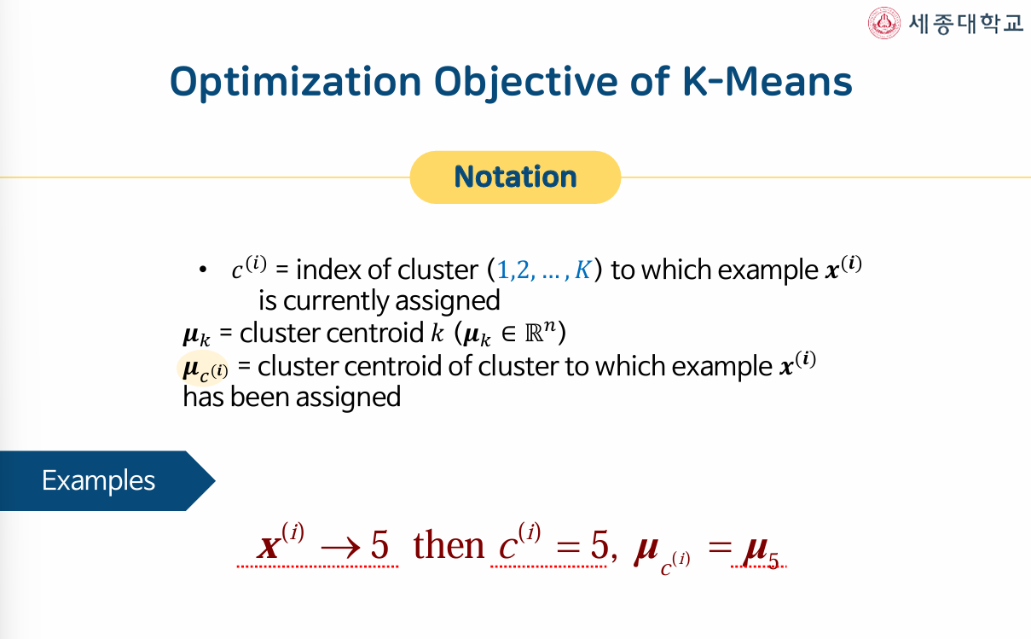
K-Means Algorithm

Slide 31
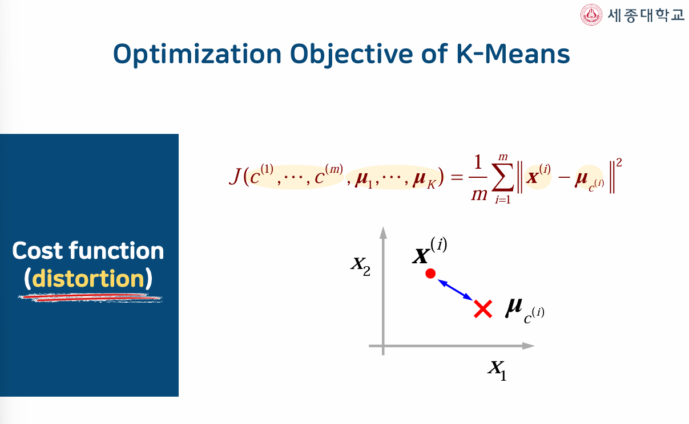
K-Means Algorithm

Slide 32
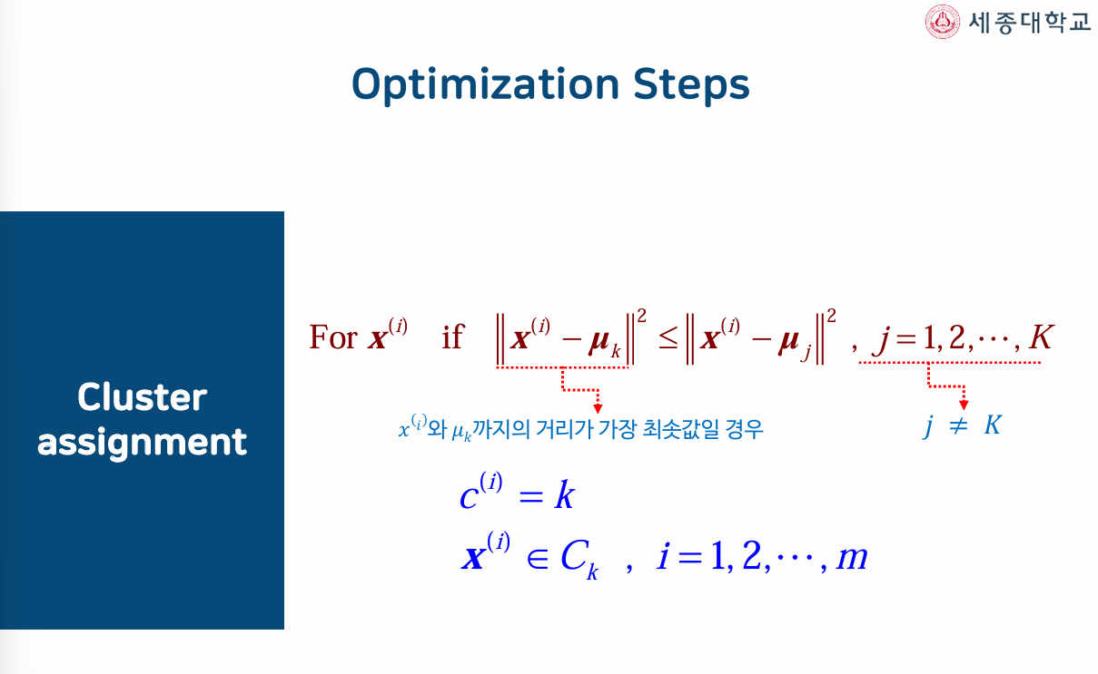
K-Means Algorithm

Slide 33
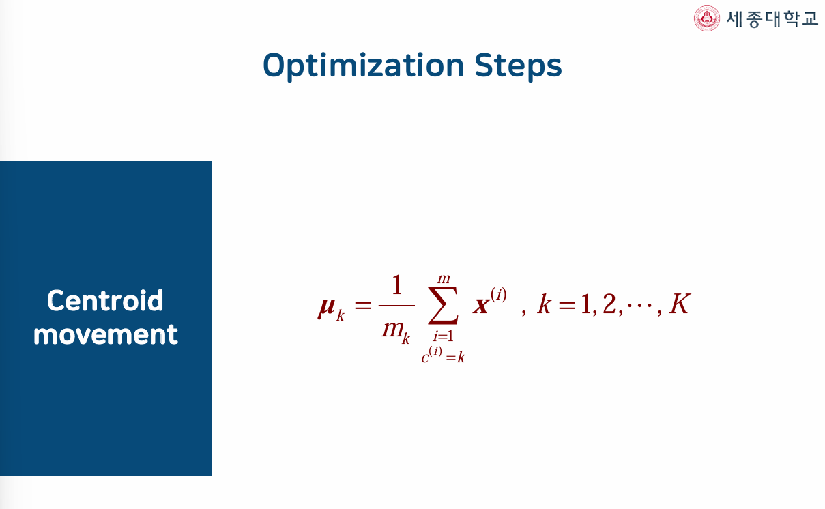
K-Means Algorithm

Slide 34
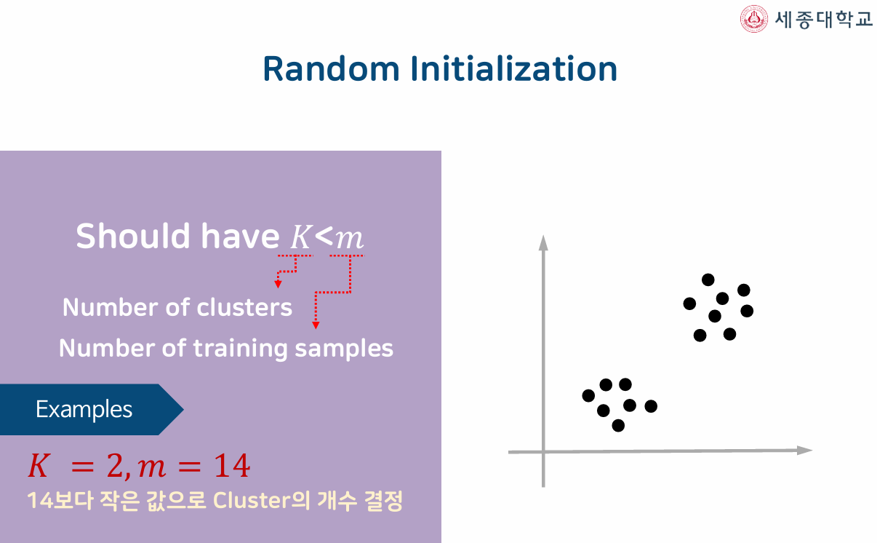
K-Means Algorithm

Slide 35
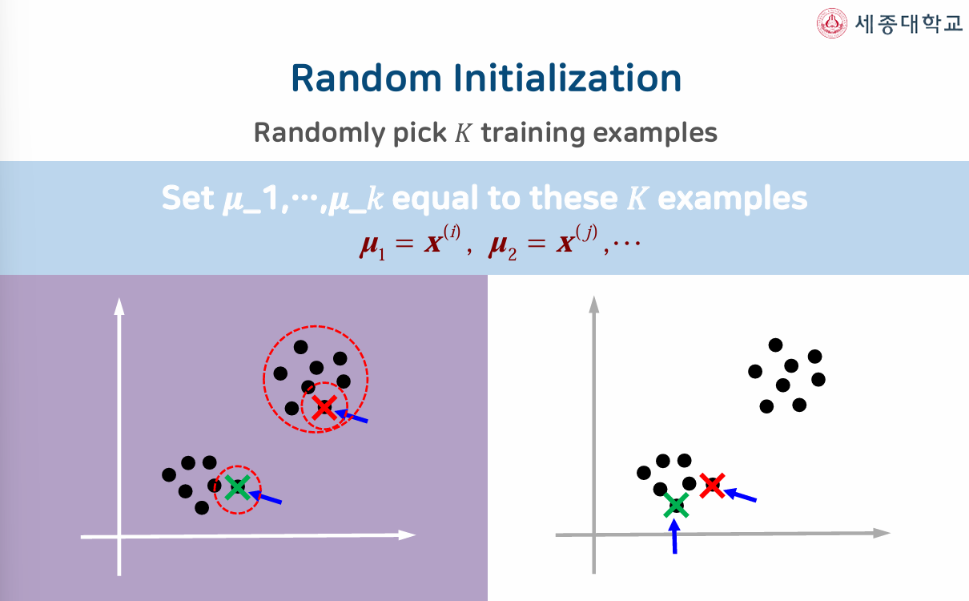
K-Means Algorithm

Slide 36
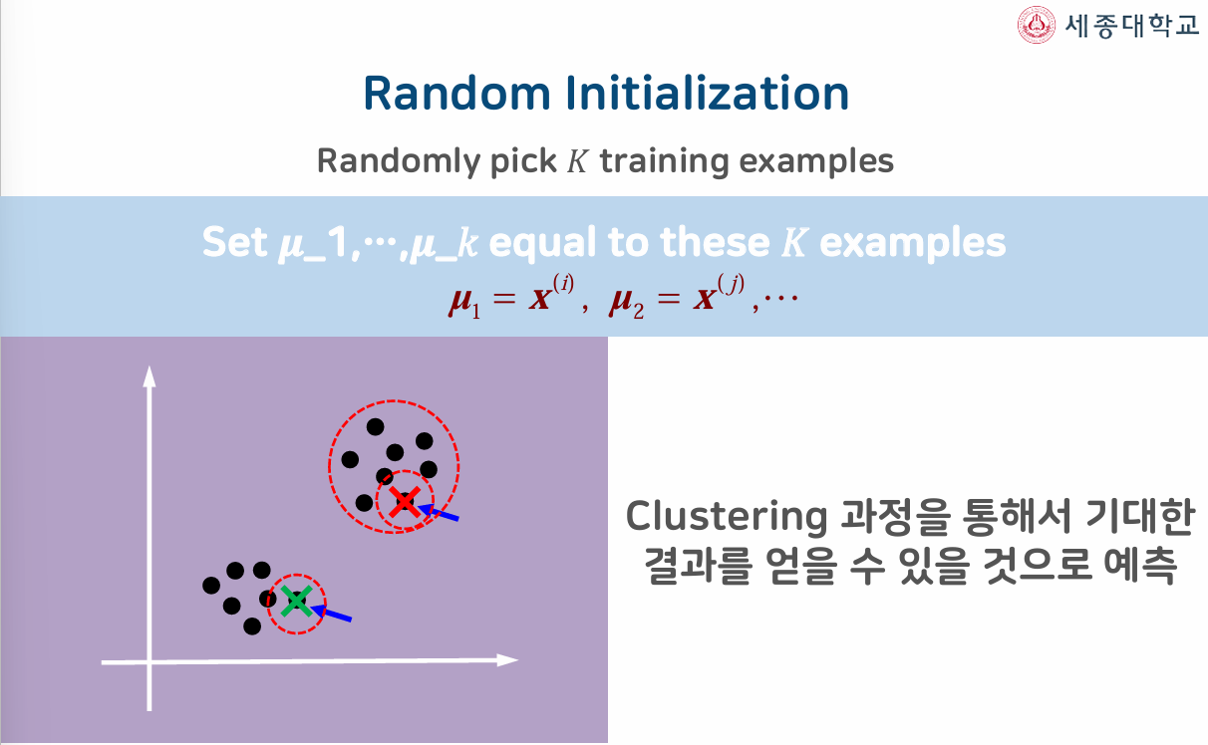
K-Means Algorithm

Slide 37
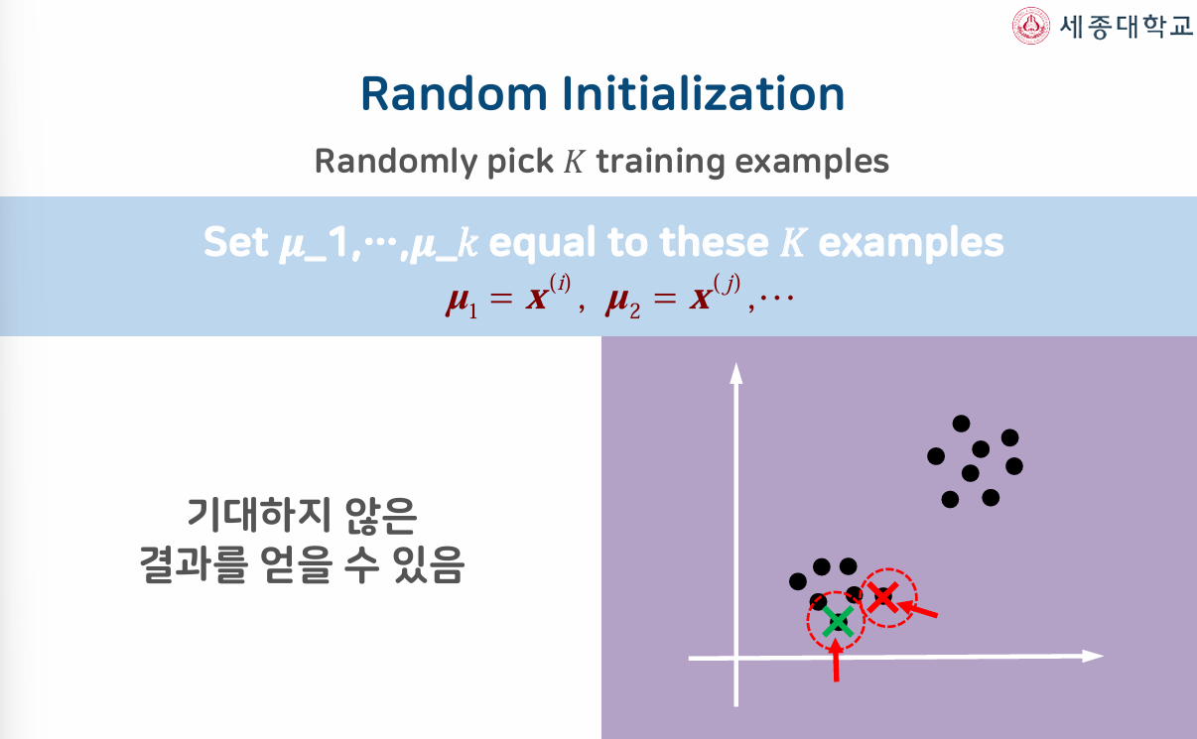
K-Means Algorithm

Slide 38
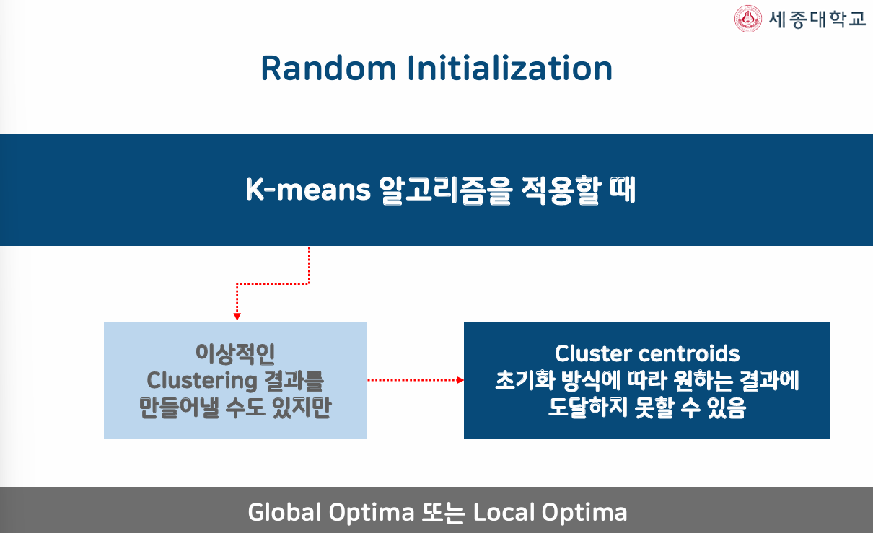
K-Means Algorithm

Slide 39
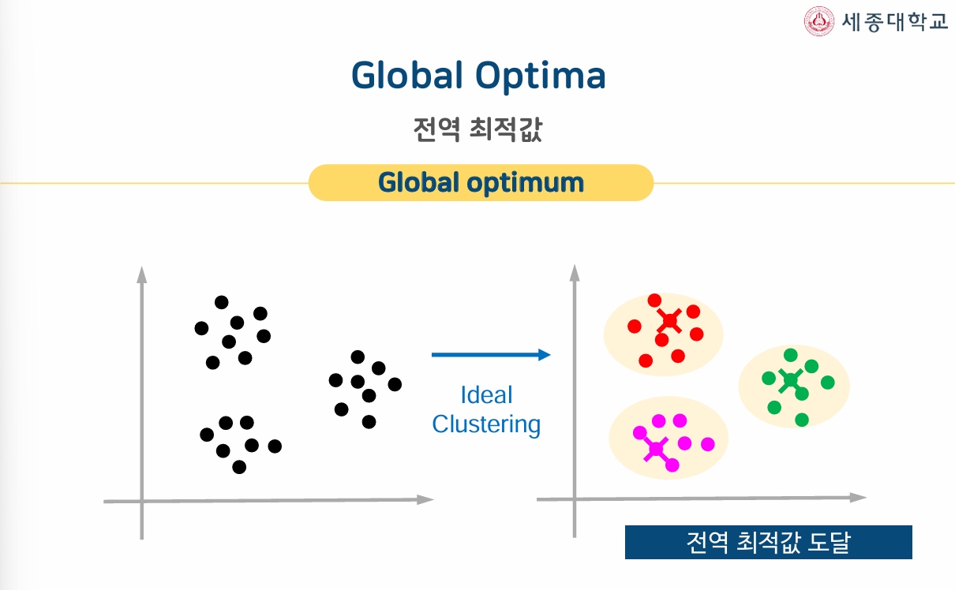
K-Means Algorithm

Slide 40
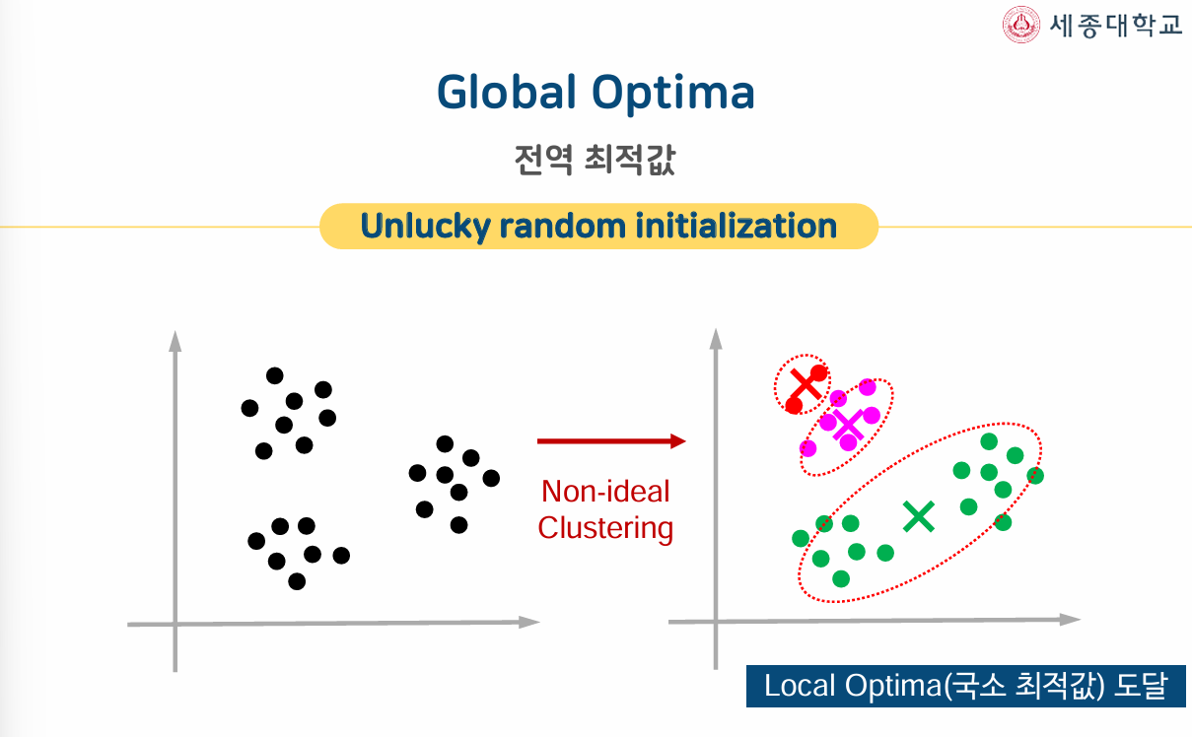
K-Means Algorithm

Slide 41
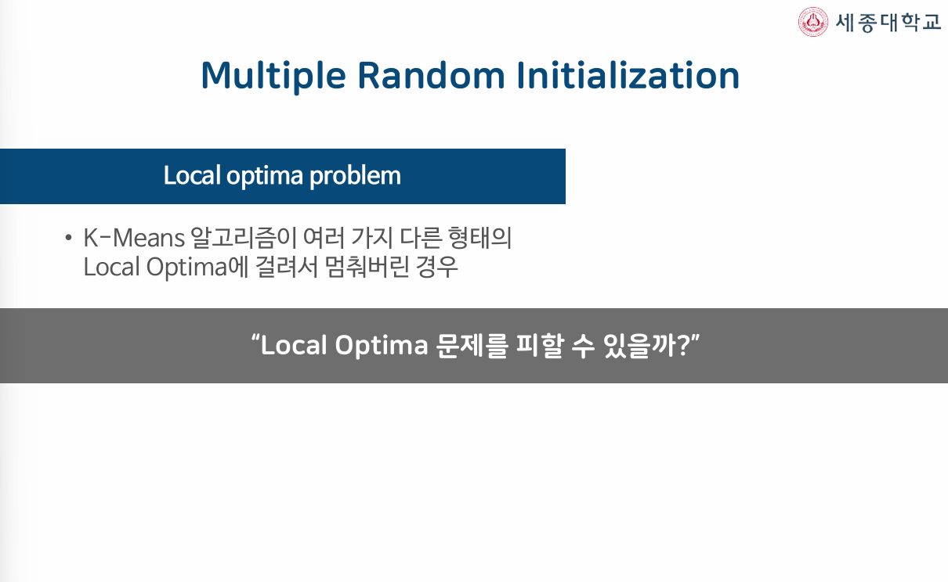
K-Means Algorithm

Slide 42
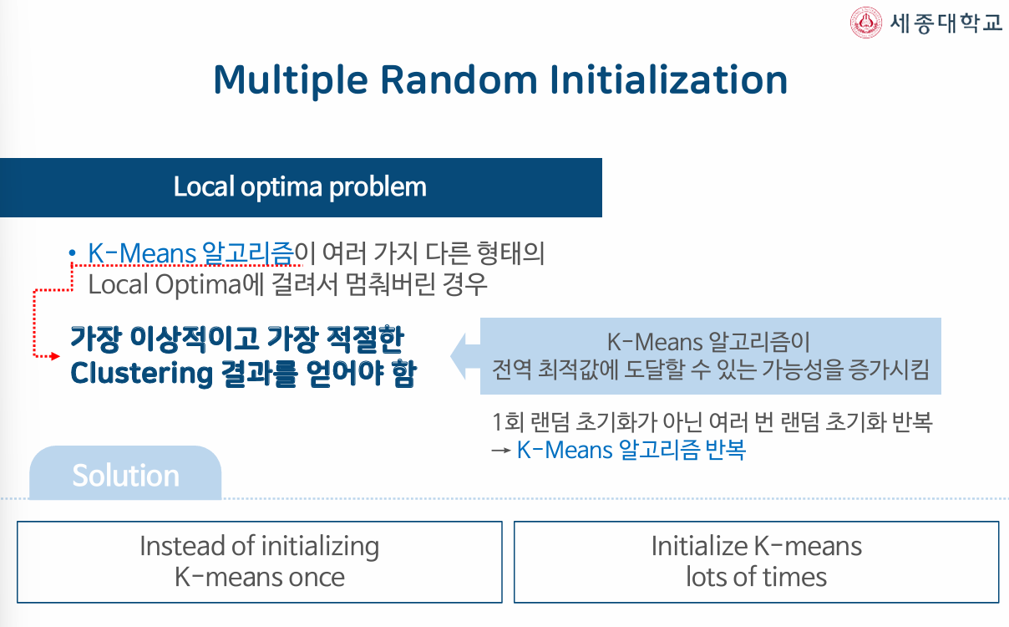
K-Means Algorithm

Slide 43
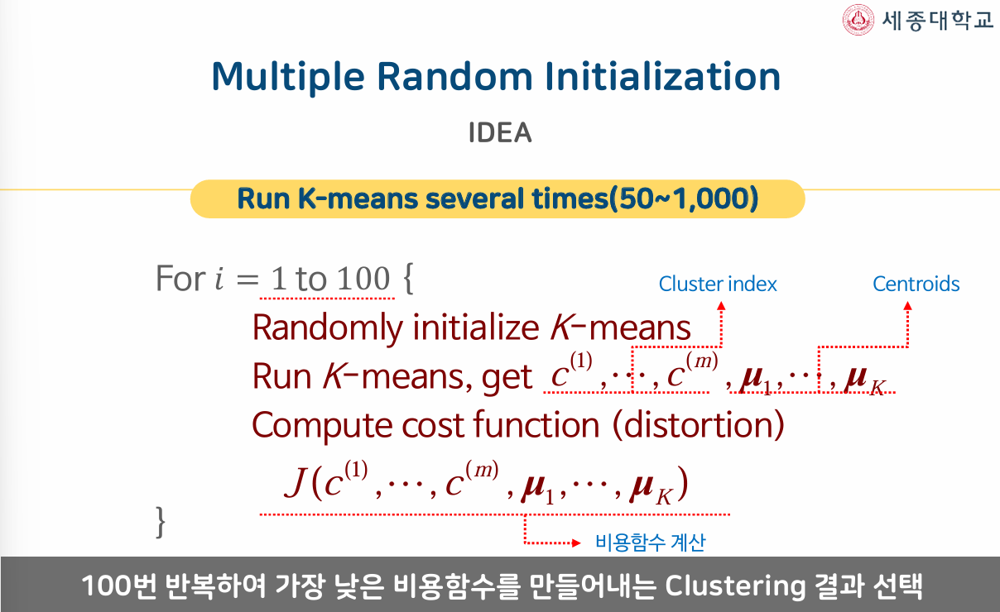
K-Means Algorithm

Slide 44
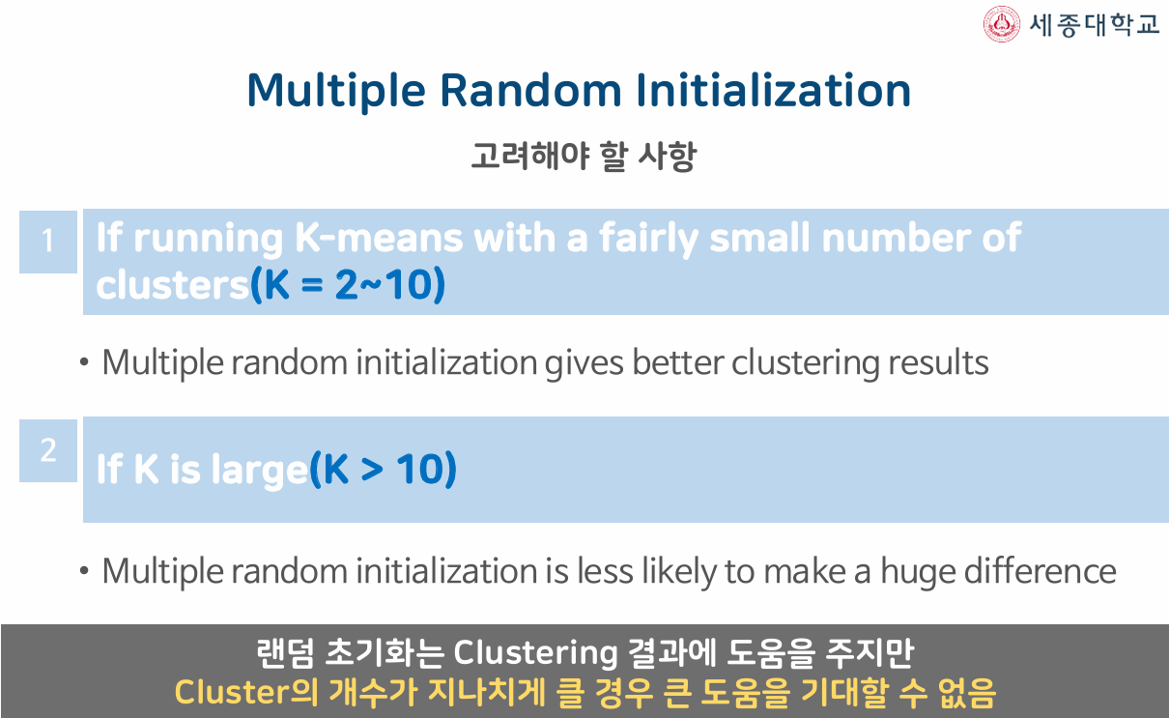
K-Means Algorithm

Slide 45
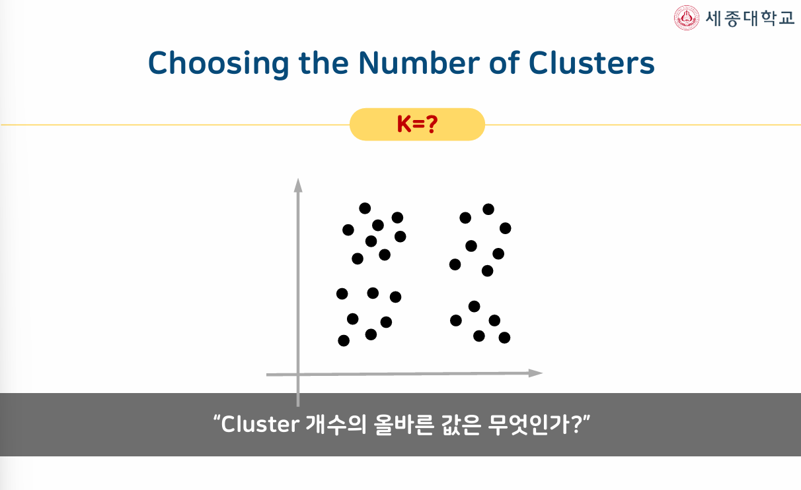
K-Means Algorithm

Slide 46
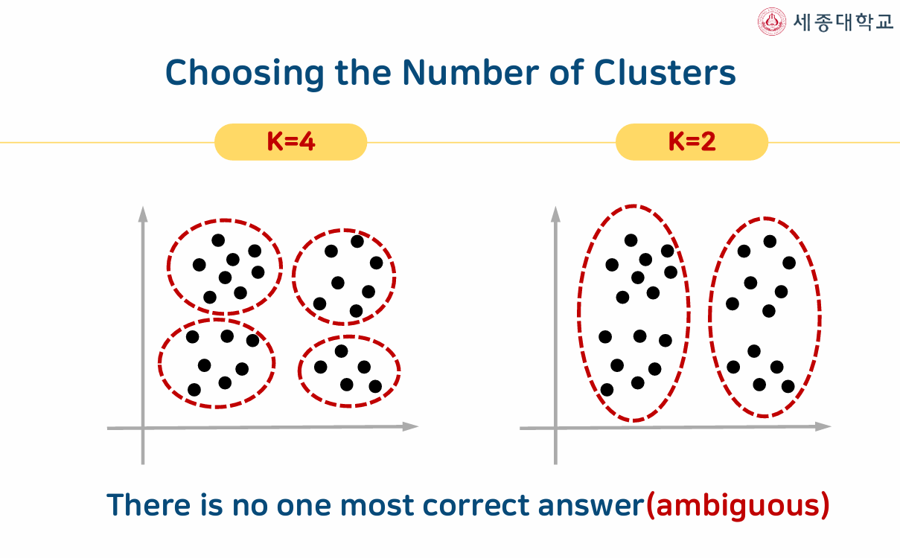
K-Means Algorithm

Slide 47
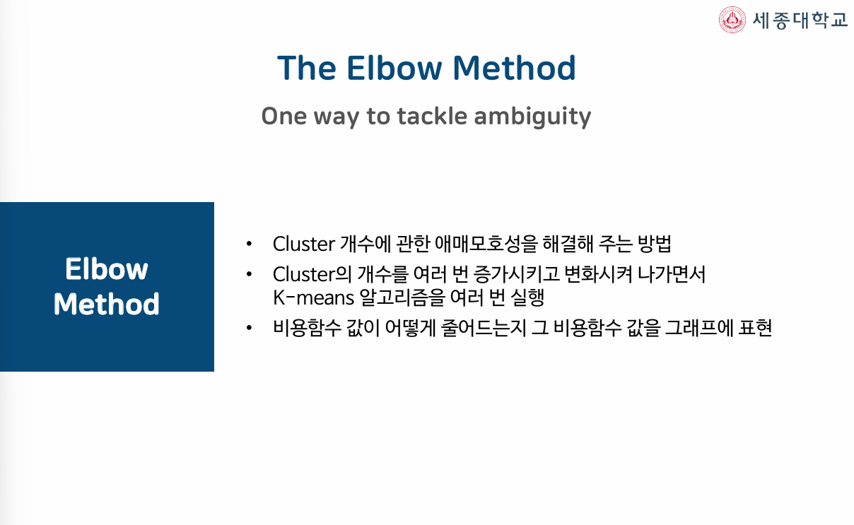
K-Means Algorithm

Slide 48
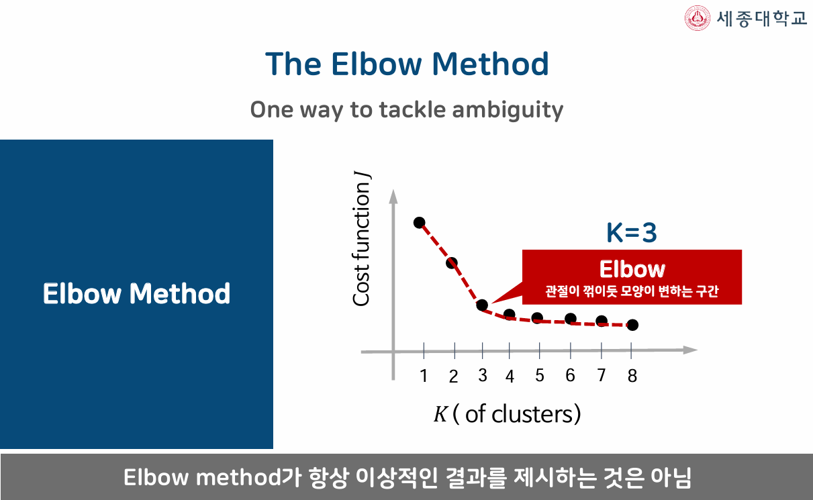
K-Means Algorithm

Slide 49
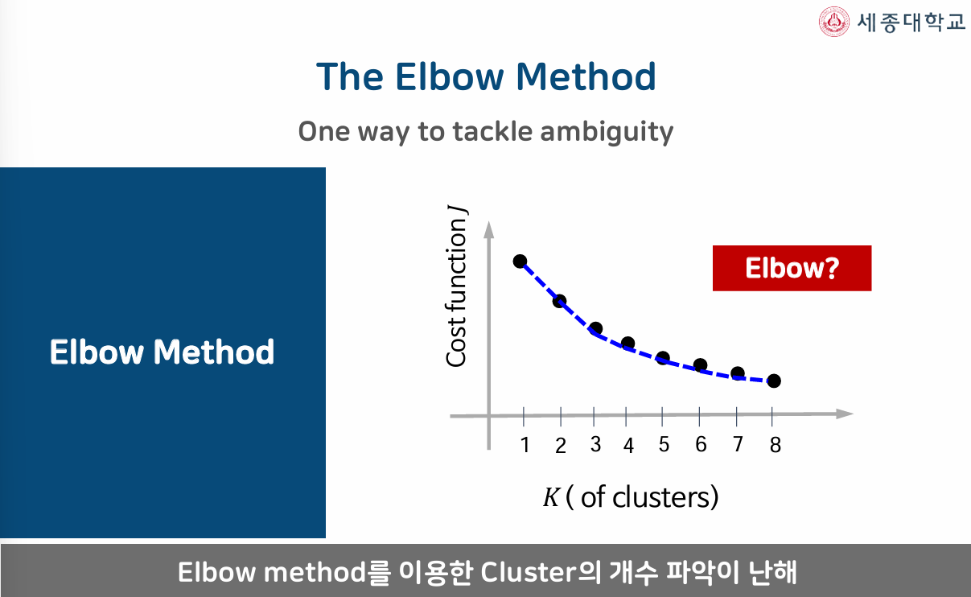
K-Means Algorithm

Slide 50
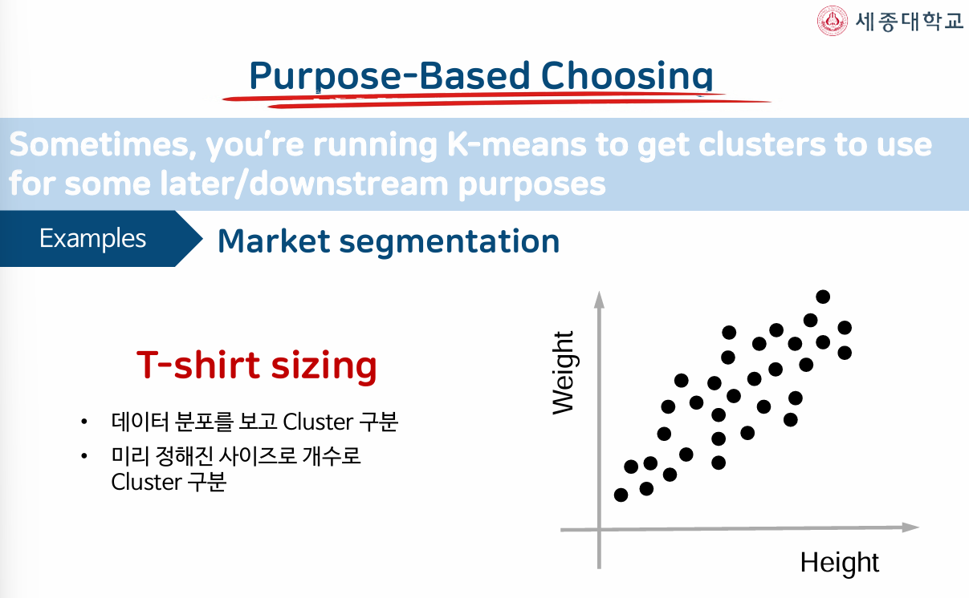
K-Means Algorithm

Slide 51
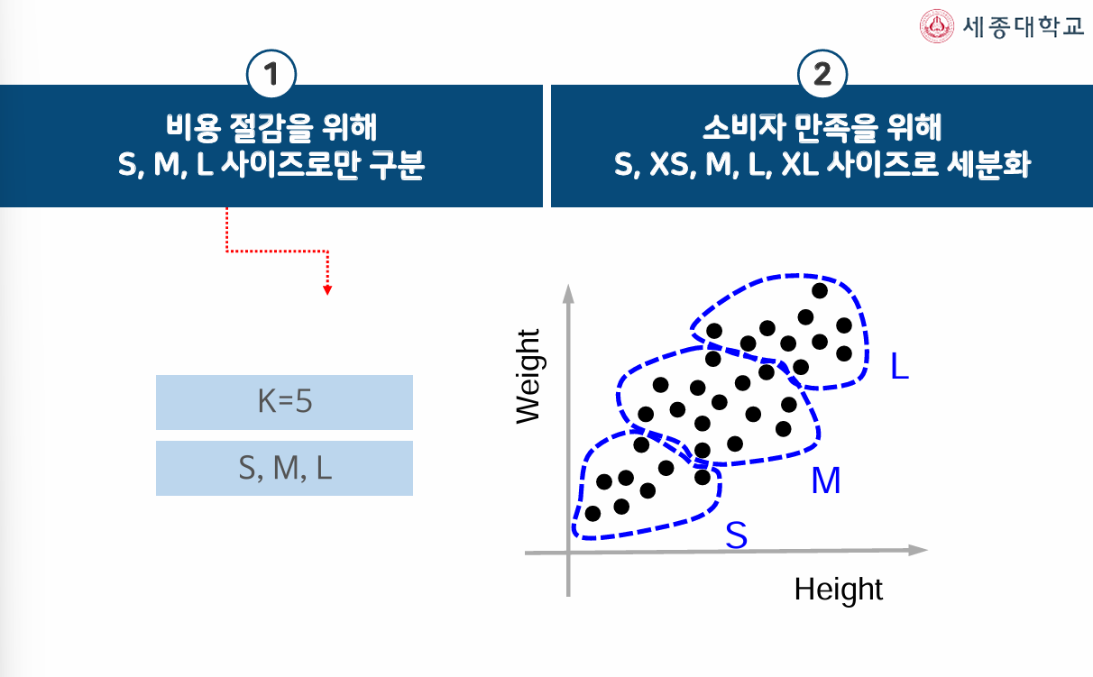
K-Means Algorithm

Slide 52

K-Means Algorithm

Slide 53
K-Means Algorithm

Slide 54
K-Means Algorithm

